Slide 1

One Dimensional Reaction-Diffusion equation with Holling Type II Functional Response
Anmol Chopra (2015A1PS0702G)
Jai Tushar (2017PHXP0020G)

Slide 2
The Model
Fisher – Kolmogorov
Non-dimensionalised equation
Logistic Growth Rate
Functional Response
The second order change of prey with spatial co-ordiantes (x in this case)
Notes:
2

Slide 3
Interpretation of the model
The equation models a species which is harvested or predated,
and the rate of predation has a saturation limit as
Homogeneous Dirichlet boundary condition signify that the
Solution presumes the value zero for each point on the
Boundary or we can say that there is no movement across the
boundary. So in our case we can assume that any individual of
the prey species cannot survive outside of Ω and even on the
boundary. An example could be an isolated island or a high
voltage electric fence around the Jurassic Park.
Notes:
3

Slide 4
Discretization of the Problem
Using Backward in time and central in space we reduce our problem to the following discretization,
Time
direction
k
h
Space-direction
Number of unknowns are N – 1.
Notes:
4

Slide 5
Iterative - Scheme
Let
Be an approximation
. Then
Using Backward in time and central in space we reduce the problem to the following discretization,
and
,
For both the boundarypoints fulfilling Dirichlet boundary conditions,
Notes:
5

Slide 6
Solution of the Problem
Substituting the iterative scheme in our equation, we get
On further simplification and letting
We get,

Slide 7
Solution of the Problem
Now we apply Newtons method to these system of algebraic equations.

Slide 8
Newton’s Method
Iterative Scheme
Corresponding Jacobian forms a tri-diagonal system!

Slide 9
Newton’s Method

Slide 10
Newton’s Method – Initial Guess

Slide 11
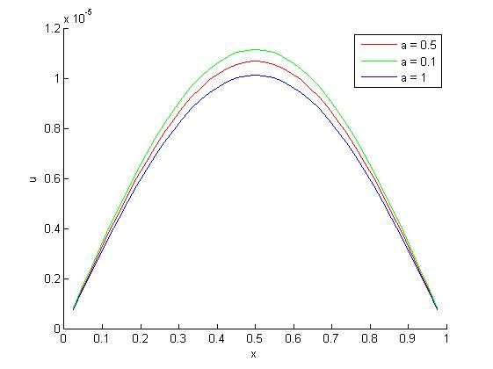
Dissipation
Graph of our approximate solution corresponding to parameters

Slide 12
Refferences
[1] Lecture Notes.
[2] Math 490-01, Partial Differential Equations and Mathematical Biology Spring 2004, Prof. Junping Shi.
[3] Mathworks.

